Slide 1


Welcome!
Workshop
2 of 7

Slide 2
Today's Topics
Review of Workshop 1
Basic VI Structure
Arrays
Clusters
Error Cluster
Enumerations

Slide 3
Review Question 1
Which of the following are the three parts of a VI?
Front Panel
Project
Block Diagram
Connector Pane/Icon

Slide 4
Review Question 1
Which of the following are the three parts of a VI?
Front Panel
Project
Block Diagram
Connector Pane/Icon
Notes:
The project helps organize your VIs that are related to one another (as well as other files). A project is not part of a VI, instead it contains VIs

Slide 5
Review Question 2
Which identifies the control or indicator on the block diagram?
Caption
Location
Label
Value

Slide 6
Review Question 2
Which identifies the control or indicator on the block diagram?
Caption
Location
Label
Value
Notes:
The label identifies the terminal that maps to the control or indicator that is on the front panel. Location does not matter; the value is often not seen on the block diagram; and the caption is only available on the front panel.

Slide 7
Review Question 3
Which of the following are not a nodes?
Terminals
Structures (while loop, for loop)
subVIs
Wires
Functions

Slide 8
Review Question 3
Which of the following are not a nodes?
Terminals
Structures (while loop, for loop, etc.)
subVIs
Wires
Functions
Notes:
Terminals and wires are also found on the block diagram, but are not nodes.

Slide 9

Review Question 4
Which function executes first: Add or Subtract?
Add
Subtract
Unknown

Slide 10
Review Question 4
Which function executes first: Add or Subtract?
Add
Subtract
Unknown
Notes:
Add will execute before subtract because the subtract function is dependent on the output of add. The subtract cannot execute until it receives the output from add.
Note: We do not know if Add or Random Number will execute first – either can.

Slide 11
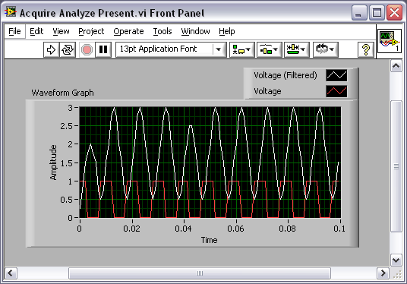
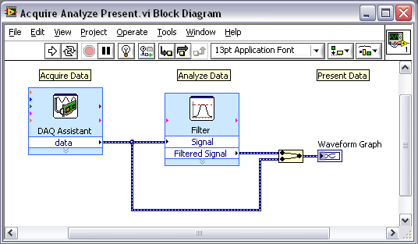
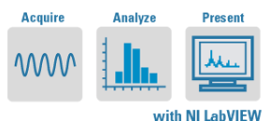
Basic VI Structure
Acquire
Analyze
Present
Notes:
The most basic VI structure is to first acquire data (from an instrument, file, etc), then analyze (or in some way manipulate- filter, add a gain, subtract noise, curve fit, etc), and finally present the results to the user (maybe through a graph, or an LED that says Pass/Fail)

Slide 12
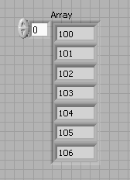
Arrays
An array consists of elements and dimensions
Elements: data that make up the array
Dimension: the length, height, or depth of an array
(2³¹)–1 elements per dimension, memory permitting
1 or more dimensions
Index, tells dimension
(1D, here)
Elements (numeric, here)
Notes:
12
Array: Arrays group data elements of the same type. An array consists of elements and dimensions. Elements are the data that make up the array. A dimension is the length, height, or depth of an array. An array can have one or more dimensions and as many as (231) – 1 elements per dimension, memory permitting.

Slide 13


Arrays: the index
The index (zero-based) tells you :
the dimension of the array (1D, 2D, 3D, etc.)
the index of the element displayed in the upper left corner
- the 1D array below is displaying index 1 to contain a value of 3.00; we do not know the value of index 0 from this image because the value at index 0 is hidden from view
2D Array (uninitialized)
1D Array (initialized)
(row)
(column)
index
TIP: drag the edge of the index to add another dimension to an array
Notes:
To add dimensions to an array one at a time, right-click the index display and select Add Dimension from the shortcut menu. You also can use the Positioning tool to resize the index display until you have as many dimensions as you want.
The index display tells you the index (location) of the element that is currently displayed in the box in the upper right-hand corner of the array. Imagine the border of the array like a window into a giant speadsheet of numbers, where the spreadsheet can slide around behind the window. The index will tell you how much the spread sheet has slid around from its home position, where the window shows the top left corner of the spreadsheet values. Therefore, the 1D array is hiding index 0 and possibly other values at index 3 or more.
The index is zero-based, meaning it begins it counting with zero.
Uninitialized arrays will have a gray background and grayed-out numbers. If you have a value at index 1,1 in an array (which would be a 2x2 array), then column 3 will be uninitialized and all columns less than 3 (0,1,2) must be initialized . Keep in mind an array is defined to be a 2x2 by the number of rows/columns that are initialized, not just the number of columns and rows being displayed through the “array window”.
Introduction to LabVIEW Hands-On 61 ni.com

Slide 14
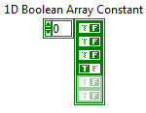
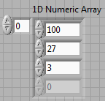
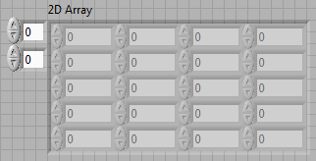


Arrays: the elements
Arrays can be of many different data types, but only one data type at a time
Notes:
14
All the elements in an array must have the same data type, because arrays, by definition, are a way to group items of the same data type.

Slide 15
Arrays: Initialized and Uninitialized
If the elements of an array are grayed out, then those elements are uninitialized.
Uninitialized elements do not have a value and are place holders
Uninitialized elements
Initialized elements
Notes:
15
The uninitialized elements are outlined in red; the initialized elements are outlined in black.
Initialized elements have a value. Uninitialized elements are just place holders, so they don’t have a value. They are spots that values can be added.
When determining the size of an array, only the initialized elements are considered.

Slide 16
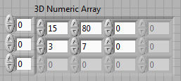
Arrays: Size vs. Dimension
Size is the number of initialized elements in each dimension
Dimension is how the elements are organized
Size: 4
Dimension: 1D
Size: 0x0
Dimension: 2D
Size: 4
Dimension: 1D
Size: 2x3x?
Dimension: 3D
Size: at least 4 – more elements could be hidden
Dimension: 1D
Notes:
16
To determine the size of a 1D array, count the number of initialized elements
To determine the size of a 2D array, count the number of initialized elements in a row and the number of initialized elements in a column

Slide 17
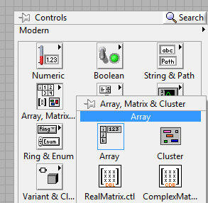
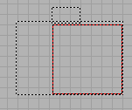
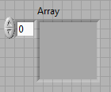
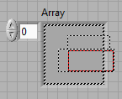

Creating an Array
Place an array shell on the front panel
From the Controls»Modern»Array, Matrix, and Cluster subpalette, select the Array icon.
Drag a data object or element into the array shell
Notes:
To create an array control or indicator as shown, select an array on the Controls»Modern»Array, Matrix, and Cluster palette, place it on the front panel, and drag a control or indicator into the array shell. If you attempt to drag an invalid control or indicator such as an XY graph into the array shell, you are unable to drop the control or indicator in the array shell. Once a valid item is placed in the array shell, the array shell shrinks to fit around the control or indicator. You can then drag the edge of the array to display more elements.
Array shells are available on the front panel and block diagram, but you must insert an object in the array shell before you use the array on the block diagram. Otherwise, the array terminal appears black with an empty bracket.
© National Instruments Corporation 60 Introduction to LabVIEW Hands-On

Slide 18
Demonstration 1:
Creating an array
Notes:
http://zone.ni.com/devzone/cda/tut/p/id/12344
Introduction to LabVIEW Hands-On 24 ni.com

Slide 19





Array Functions
Array Size:
Returns the number of elements in each dimension of the array
Index Array:
Returns the value at the index you specify
Initialize Array:
Creates an initialized array of the dimension and data type you specify
Build Array:
Adds elements or dimensions to an array
Search 1D Array:
Returns the index of the value you specify; if not found, returns -1
Notes:
There are many more array functions; however, these are the ones that are often used.

Slide 20
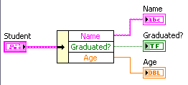
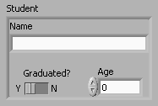
Clusters
Clusters group data elements of mixed types
Similar to a record or a struct in text-based programming languages
Notes:
20
Cluster: Clusters group data elements of mixed types. Often the objects have a relationship with one another from the perspective of the user or programmer (such as the student’s name [string], age [numeric], and graduation status [boolean]).
Cluster are created in a similar fashion to arrays: place a shell, then add object into the shell.

Slide 21


Cluster Functions
Bundle (there is also Unbundle)
Assembles a cluster from individual elements.
Bundle By Name (there is also Unbundle By Name)
Replaces one or more cluster elements. This function refers to cluster elements by name instead of by their position in the cluster.
Cluster Constant
Use this constant to supply a constant cluster value to the block diagram.
(Terminal labels reflect data type)
Bundle By Name
Cluster Constant
Bundle
Notes:
The terms bundle and cluster are closely related in LabVIEW.
Example: You use a bundle function to create a cluster. You use an unbundle function to extract the parts of a cluster.
Bundle - Forms a cluster containing the given objects in the specified order.
Bundle by Name - Updates input cluster’s element values (the object must have an owned label). *requires input cluster*
Unbundle - Splits a cluster into each of its individual elements by data type.
Unbundle by Name - Returns the cluster elements whose names you specify.
Two major difference between Unbundle/Bundle and Unbundle By Name/Bundle By Name: (1) “By Name” = label of elements visible (not just the data type. (2) Bundle By Name requires an input cluster and updates, instead of creating a new cluster.
Introduction to LabVIEW Hands-On 81 ni.com

Slide 22
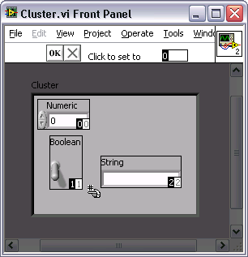
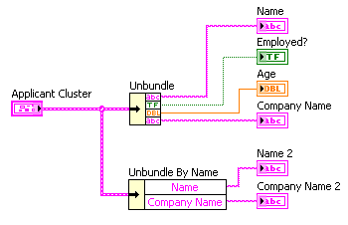
Clusters: Order
Cluster elements have a logical order unrelated to their position in the shell
You can view and modify the cluster order by right-clicking the cluster border and selecting Reorder Controls In Cluster from the shortcut menu
Order determines how cluster is unbundled
Notes:
22
The order in clusters is important to…
the user if they want to tab through the objects (ie, input value 1, tab, input value 2, tab….)
-the programmer because the order is what defines the order in which items are unbundled from a cluster using the Unbundle function. The Unbundle By Name function will display the label of the items, but the Unbundle function only displays the data type. Therefore, the only way to determine which string output is at the top of the Unbundle function when there are multiple strings in the cluster is through the order.
The initial order of a cluster is determined by the order in which elements are added. If I add a numeric, a boolean and then a string; the order will be numeric=0, boolean=1, string=2.
When reordering, the number displayed in the menu bar (outlined in red on this slide) will be the new order number given to the element that you next click on. It will increment after an item is clicked. You can enter a value, such as 4, to specify the new value. In other words, you do not have to start at zero and click through every element of the cluster.

Slide 23

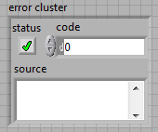
Error Cluster
Three parts:
Status – Boolean, TRUE when an error occurred
Code - numeric (I32), identifies which error occurred
Source – string, identifies where the error occurred
Note: Warnings have a code and source, but the status is FALSE
Notes:
23

Slide 24
Demonstration 2:
Creating a cluster and reordering its element
Notes:
http://zone.ni.com/devzone/cda/tut/p/id/12344
Introduction to LabVIEW Hands-On 24 ni.com

Slide 25
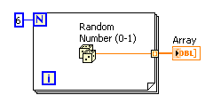
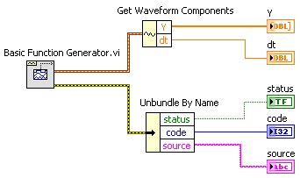
Clusters vs. Arrays
Clusters differ from arrays in that they are a fixed size
Clusters can contain mixed data types; arrays contain only one data type
Like an array, a cluster is either a control or an indicator and cannot contain a mixture of controls and indicators
You can create a cluster of clusters, cluster of arrays, array of clusters, but NOT an array of arrays
Notes:
Cluster are a fixed size because you cannot add an object to an existing cluster – only change the values within the object. You can create a new cluster which contains an existing cluster (cluster within a cluster), but this is still a new cluster.
Great article about Arrays and clusters: http://zone.ni.com/devzone/cda/tut/p/id/7571

Slide 26
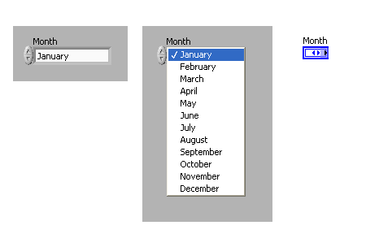
Enumeration
An enum represents a pair of values, a string and a numeric, where the enum’s value is one of a defined list of value pairs
Appears as a string to you, and a number to computer
Notes:
An enum (short for enumeration) is a data type that pairs a number with a string (ie, months of the year with the number 0-11).
The list of pairings is maintained as part of the data type (this is important when it comes to type definitions and is different from a ring, which looks similar)

Slide 27
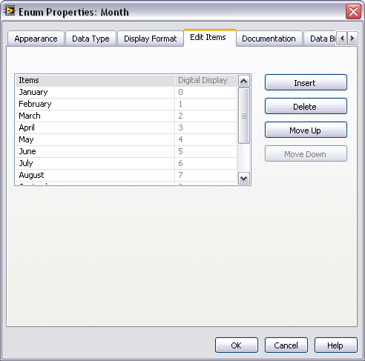
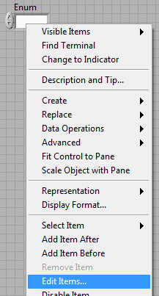
Enumeration: Configuring
Right-click on the enum
Select Edit Items…
Notes:
Right-click and select Edit Items… to bring up the window in which you can add/delete/move items on the list.

Slide 28
Demonstration 3:
Configuring an Enum
Notes:
Place an enum on the front panel
Right-click on the enum and select Edit Items…
Add Start, Stop, Read to the listing (0= Start, 1=Stop, 2=Read)
Move Stop to last entry (0= Start, 1=Read, 2=Stop)
Close the Properties Window and show the entries on the front panel
Change the enum control to a constant and show the entries as a constant
- Explain that the value chosen/showing is the value of that enum
Introduction to LabVIEW Hands-On 24 ni.com

Slide 29
Homework:
HW 2: Creating Arrays and Clusters
Notes:
Introduction to LabVIEW Hands-On 24 ni.com

